Slide 1
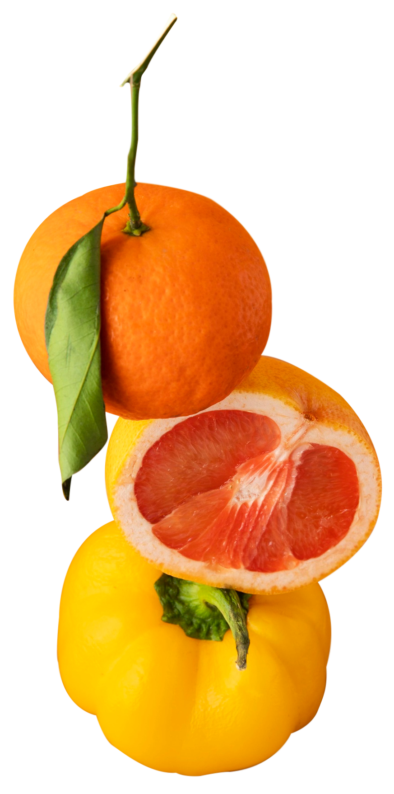
DIET COST OPTIMIZATION
D
HEALTHY LIFESTYLE - HEALTHY LIFESTYLE - HEALTHY LIFESTYLE - HEALTHY LIFESTYLE
(FOUR-WARD THINKERS) ​
No. ​ | MATRIC ID ​ | NAME ​
1 | S2195613 ​ | Li Xin Qi​
2 | S2155659 ​ | Lim Yu Xuan (Hilary)​
3 | 22051081​ | Tan Kai Ying​
4 | 22050480 ​ | Lee Tse Lyn (Mavis)​
HEALTHY LIFESTYLE - HEALTHY LIFESTYLE - HEALTHY LIFESTYLE - HEALTHY LIFESTYLE
DETOX DIET - DETOX DIET - DETOX DIET - DETOX DIET - DETOX DIET - DETOX DIET
A

Slide 2
TABLE OF CONTENTS
Problem Statement
01
Introduction
02
03
Objectives
Discussion
Results & Conclusion
04
05
Modelling
06
T
PREPARE DISHES WITH VEGETABLES AND VEGETABLES
PREPARE DISHES WITH VEGETABLES AND VEGETABLES
(Study Problem, Data Collection, Algorithms and Tools Applied)
TABLE OF CONTENTS - TABLE OF CONTENTS - TABLE OF CONTENTS - TABLE OF CONTENTS
C

Slide 3
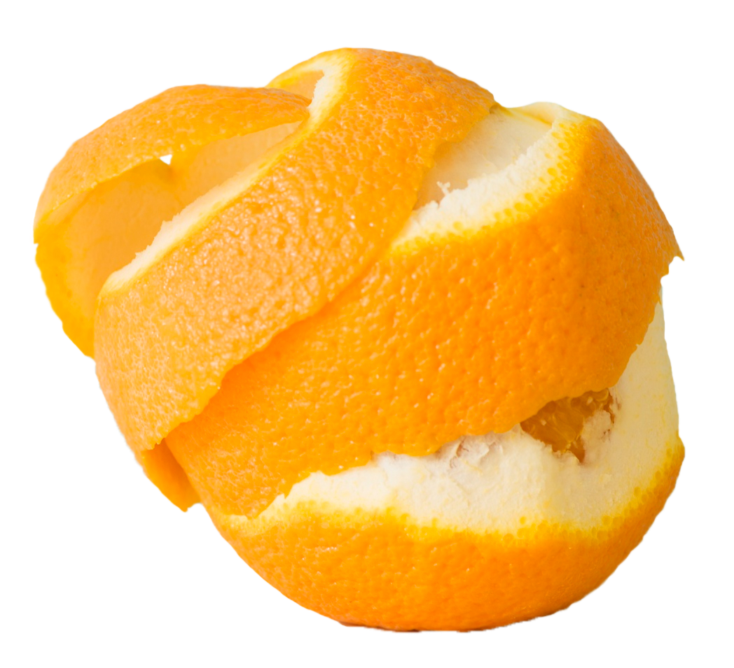
INTRODUCTION
O
DETOX DIET HEALTHY LIFESTYLE - DETOX DIET HEALTHY LIFESTYLE
Food is one of humanity's essential but maintaining a healthy diet is a problem
Communities that lack access to inexpensive nutrient-rich food can benefit from practical solutions offered through diet optimization.​
It has prompt researchers to use ML techniques to help optimize diets and lessen the cost of nutritious food.
DETOX DIET HEALTHY LIFESTYLE - DETOX DIET HEALTHY LIFESTYLE
DETOX DIET HEALTHY LIFESTYLE - DETOX DIET HEALTHY LIFESTYLE
C

Slide 4
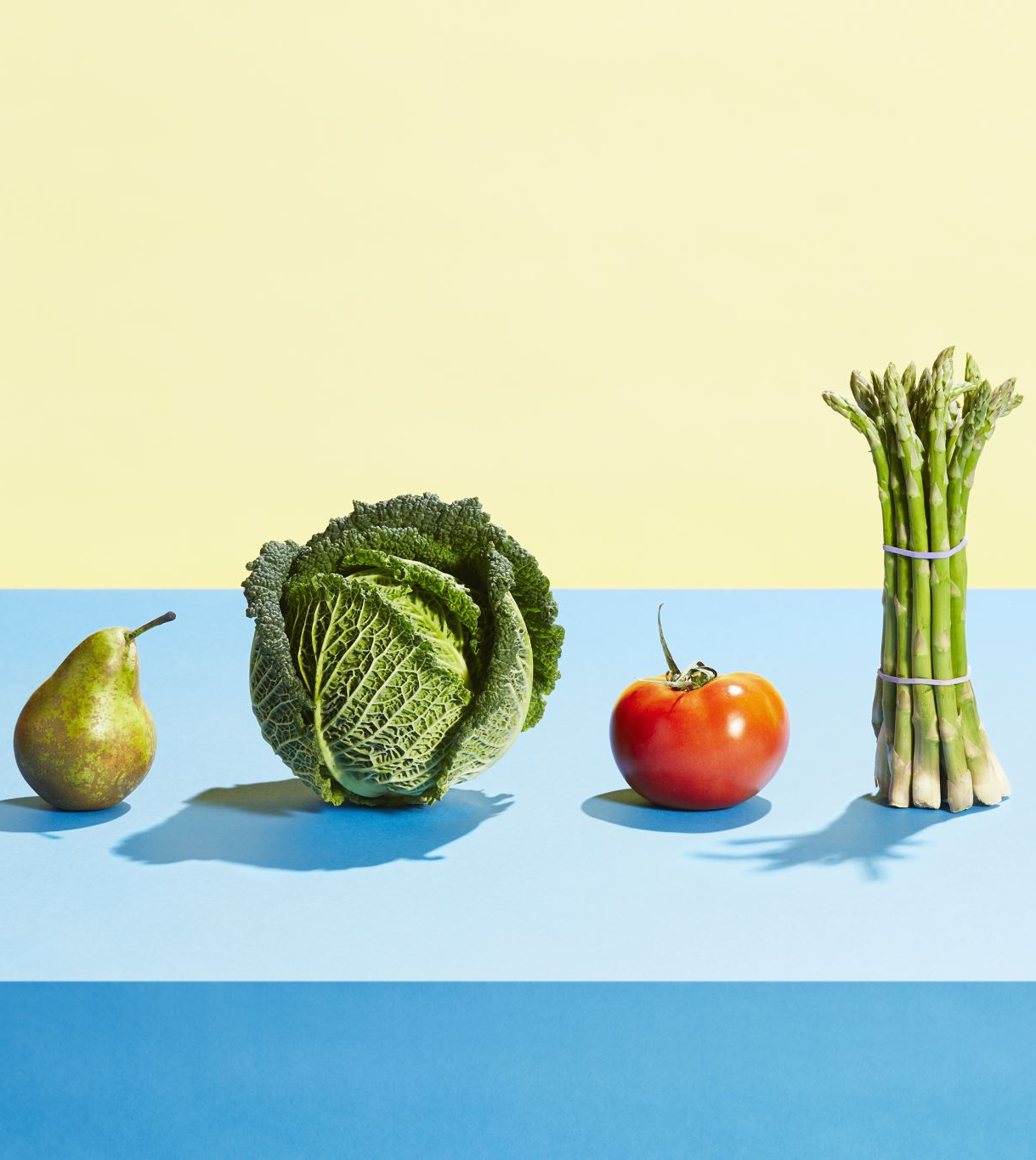
PROBLEM STATEMENT
Maintaining a healthy diet is challenging for many individuals due to budget.
Cost of healthy food items can be expensive which is why people tend to go for cheaper but less nutritious alternatives.
Machine learning algorithms and numerical optimization can help in optimizing diets:
feasible to pinpoint affordable substitutes for costly yet widely popular food
foster wholesome eating habits while reducing costs.

Slide 5
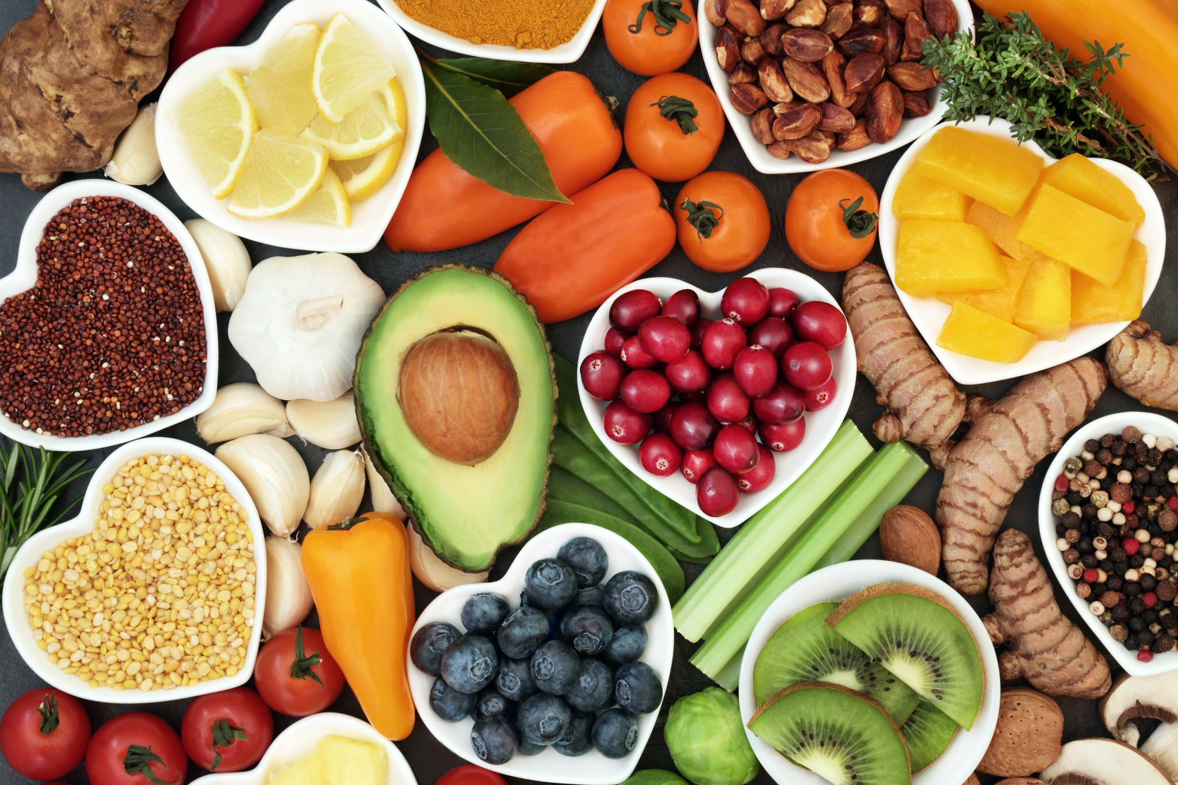
OBJECTIVES
DETOX DIET HEALTHY LIFESTYLE - DETOX DIET HEALTHY LIFESTYLE
U
To identify the right numerical optimization techniques for diet cost optimization.
To examine the constraints and limitations associated with diet cost optimization.
To build a model that finds optimal diets that meet nutritional requirements with the minimum cost.
DETOX DIET HEALTHY LIFESTYLE - DETOX DIET HEALTHY LIFESTYLE
DETOX DIET HEALTHY LIFESTYLE - DETOX DIET HEALTHY LIFESTYLE
A

Slide 6
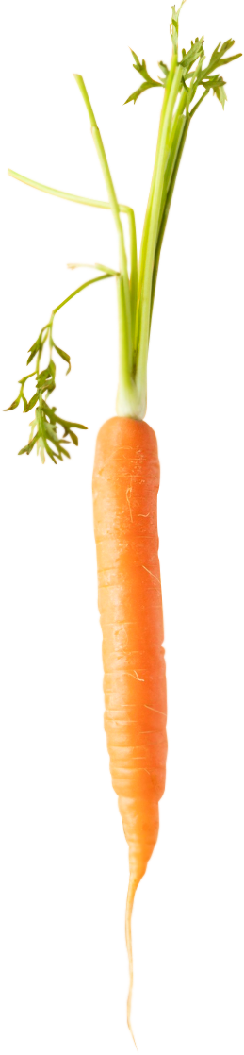
STUDY PROBLEM
P
Food prices have surged due to the Covid-19 pandemic, affecting people's ability to maintain a nutritious diet.
Machine learning techniques optimize menu planning for lower-cost and nutritionally adequate meals (Tadia, 2021).
Algorithmic models enable individuals to compare and select high-nutrition options at lower expenses (Corrêa, 2019).
These technologies benefit institutions, health-conscious individuals, and those using diet-tracking apps for weight management and overall health objectives.
MAINTAIN A HEALTHY EATING LIFESTYLE - MAINTAIN A HEALTHY EATING LIFESTYLE
MAINTAIN A HEALTHY EATING LIFESTYLE - MAINTAIN A HEALTHY EATING LIFESTYLE
A

Slide 7
Data Collection
Food Composition Data
Food Price Data
Dietary Guidelines
Nutritional Targets

Slide 8
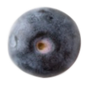
Food Composition & Price Data
Variables | Description
Food Item | 40 types of food are collected, whereby each food group contains 5 food items.
Food Group | 8 food groups based on Malaysian Food Pyramid.
Serving Size (g) | Single serving size for each food item.
Calories (kcal) | Calories in kcal for each food item per serving size.
Protein (g) | Protein in grams for each food item per serving size.
Carbohydrate (g) | Carbohydrate in grams for each food item per serving size.
Fats (g) | Fats in grams for each food item per serving size.
Cholesterol (mg) | Cholesterol in milligrams for each food item per serving size.
Fibre (g) | Fibre in grams for each food item per serving size.
Cost per serving (RM) | Cost per serving size for each food item in Ringgit Malaysia.
MAINTAIN A HEALTHY EATING LIFESTYLE - MAINTAIN A HEALTHY EATING LIFESTYLE
Notes:
The calories and nutrient composition of 40 foods are collected, where each food group contains 5 food items
The category of each food group will be described in detail later
While the serving size, nutrients and cost per serving for each food is referred online, with a reference list included in our report

Slide 9
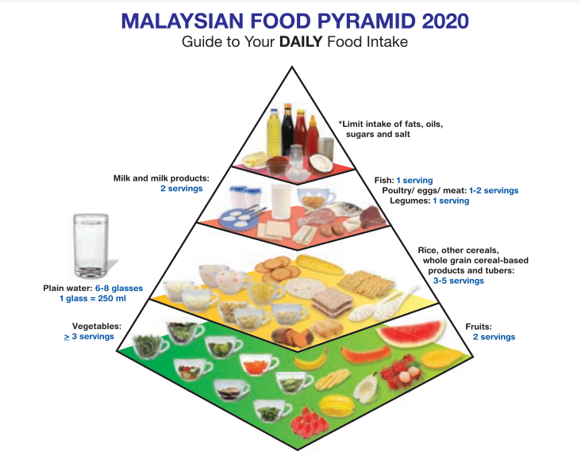
Dietary Guidelines
Notes:
The dietary guideline is based on the Malaysian food pyramid suggested by Ministry of Malaysia in 2020
We can see that the food pyramid is divided into 8 food groups, which is fruits, vege, grains, fish, poultry/eggs/meat, legumes, milk and milk products and finally fats/oils
With the recommended portion included

Slide 10
Nutritional Targets
Variables | Description
Age Groups | 4 age groups from 16 and above (16 – 17, ≥ 18 – 29, 30 – 59, ≥ 60).
Gender | Both gender (male, female).
Level of Physical Activity (PAL) | 4 levels of physical activity (PAL 1.4, 1.6, 1.8, 2.0).
Calories (kcal) | Target calories in kcal for each food item per serving size.
Protein (g) | Target protein in grams for each food item per serving size.
Carbs (g) - LB | Target carbohydrate Lower Bound in grams for each food item per serving size.
Carbs (g) - UB | Target carbohydrate Upper Bound in grams for each food item per serving size.
Fat (g) | Target fibre in grams for each food item per serving size.
Cholesterol (mg) | Target cholesterol in milligrams for each food item per serving size.
Fibre (g) | Target fibre in grams for each food item per serving size.
Notes:
The last part is the nutritional targets, which is also suggested in the Recommended Nutrient Intake (RNI) report by Ministry of Health Malaysia
Please bear that the recommended nutrient intake will be mentioned as RNI from now on.
From the table, we can see that the RNI are based on 4 age groups, 2 genders, and 4 different level of physical activity (*can determine whether need to explain what is PAL)
Which results in a total of 32 population groups
- All the data collected will be served as the input for our diet optimization model, which will go through in detail later.

Slide 11
Algorithms & Tools Applied
A
Linear programming
Linear programming optimizes complex systems and finds cost-effective solutions.
It effectively creates diet plans that meet nutritional requirements while minimizing costs.
Octave
Octave is an open-source numerical computing package for tracking food expenses and optimizing grocery shopping.
Octave can analyze and adjust spending habits to optimize nutrient balance and budget allocation.
Taking advantage of Octave's resources is a logical choice for maintaining a healthy lifestyle on a budget.
FEELING GOOD IS LOOKING GOOD - FEELING GOOD IS LOOKING GOOD
FEELING GOOD IS LOOKING GOOD - FEELING GOOD IS LOOKING GOOD
P
Notes:
* Can cut short this part if the presentation time exceed

Slide 12
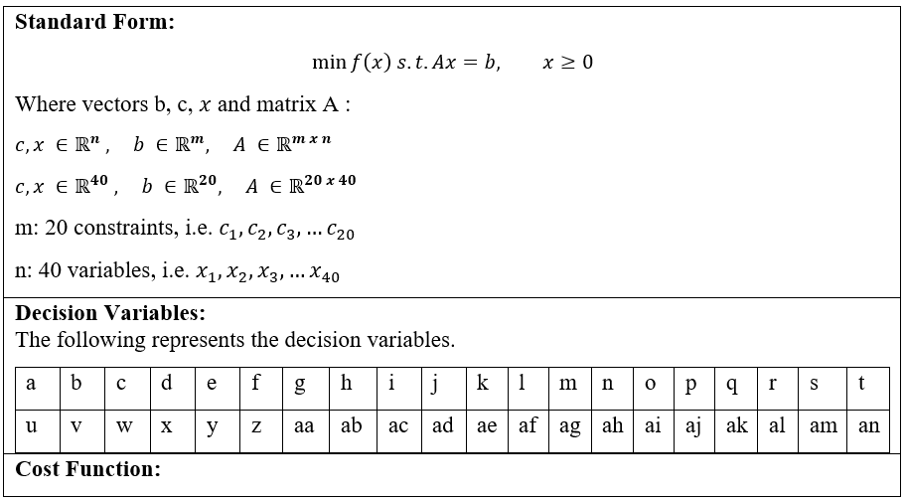
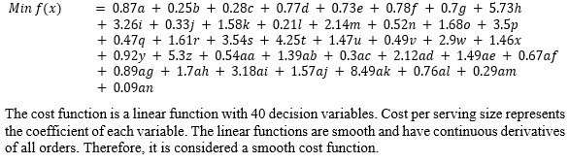
MODELLING
Selected age group as an Example: A 16-17 years old male with physical level activity of 1.4.
Constrained optimization is used to find the minimum objective function while fulfilling a set of constraints.
Both objective function and the constraints are in linear form, we are solving a linear programming type of constrained optimization problem.
Our objective is to find out the minimum cost for a healthy diet plan. 40 types of food coming from different food groups are selected to provide a variety of choices for end users.
P
Notes:
Next up, we will be discussing about the modelling. Constrained optimization is selected in this project to find the minimum cost function. All the objective function and constraints are in linear form, so we are using linear programming to solve.
The left hand side shows the equations. We will take age group of 16-17 year old young man with a level of physical activity of 1.4 as our example to determine it's minimum cost for daily food requirement and its suggested food item and size.
There are a total of 40 food type as a selection, thus 40 decision variables from a, b, to an.
For the cost function, the coefficient of each food is derived from the cost per serving size.

Slide 13
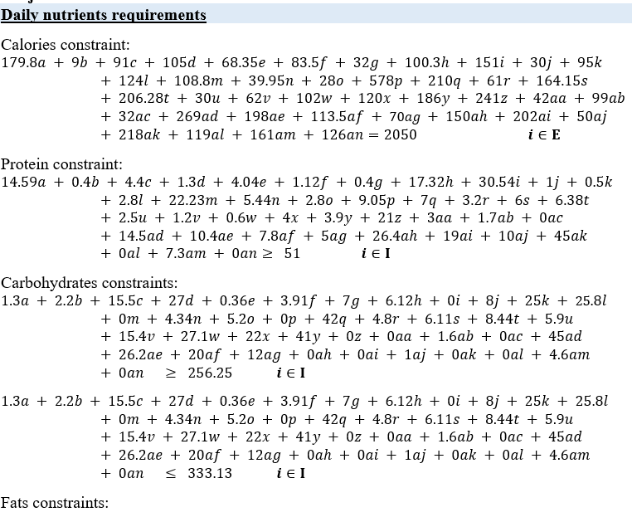
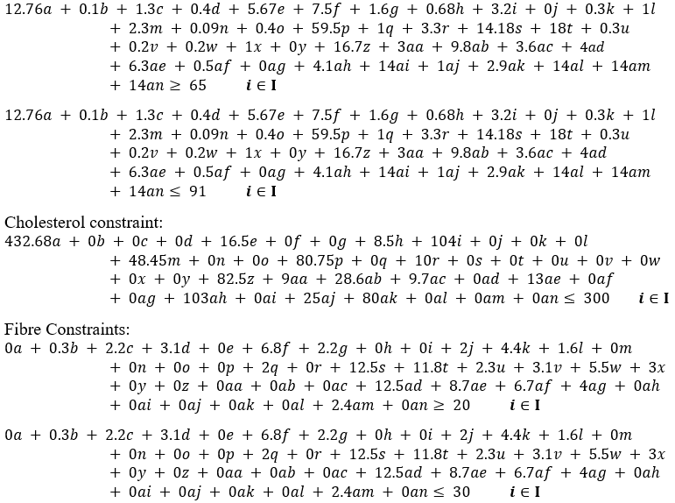
A
FEELING GOOD IS LOOKING GOOD - FEELING GOOD IS LOOKING GOOD
There are a total of 20 constraints which consist of both equality (Ε) and inequality (Ι) forms.
Below is the daily nutrients requirements constraint group.
P
Notes:
There are a total of 20 constraints which consist of both equality (Ε) and inequality (Ι) forms.
The first constraints group is daily nutrient requirement. As we can see, the coefficient of calories constraints is derived from the calories of each food item per serving size. The right-hand side vector 2050 calories is derived from the daily nutrients' requirement of each individual based on the Recommended Intake table. Same go for protein, carbohydrates, fats, cholesterol, fiber Constraints.

Slide 14
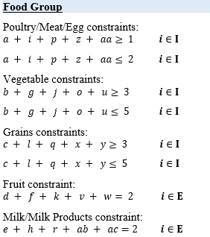
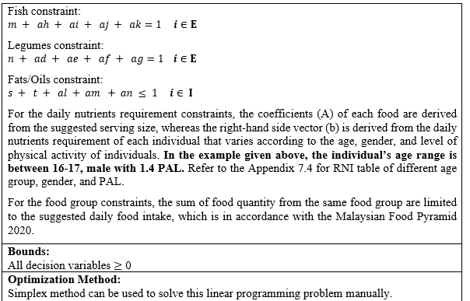
A
Below is the 8 food groups constraint group, along with the decision variable constraint and optimization method applied.
P
Notes:
The next constraints group is food group. The constraint equation is based on the Malaysian Food Pyramid. For example, food item a, I, p z and aa belong to the meat group and the suggested serving portion for this food group is 1 to 2. That’s why from the equation we constrained it by using two inequality forms. Same go for vegetable, grains, fruit, milk/milk product, fish, legumes, Fat/oil Constraints.
For the bounds, decision variable should not be in negative values.
And the optimization method used can be simplex method when calculating manually. From here, due to the complexity, we shall use Octave to solve it.

Slide 15
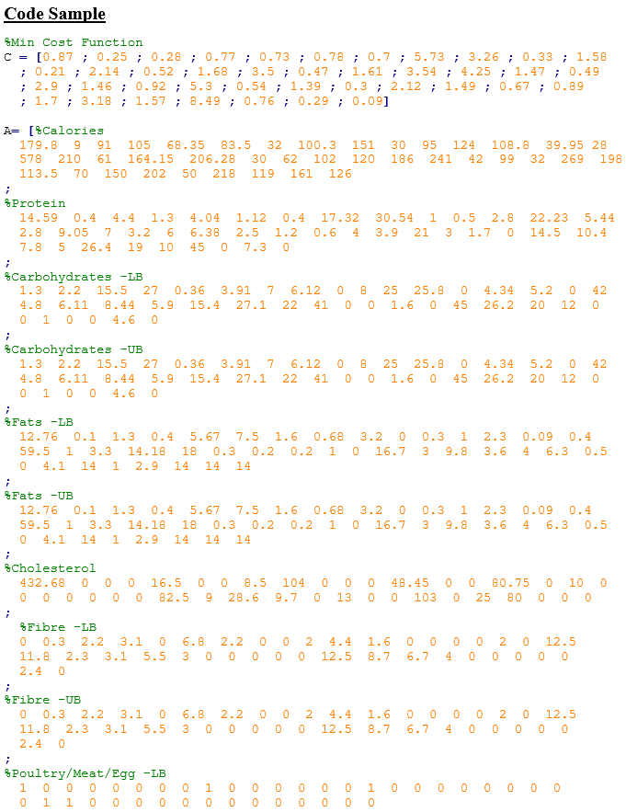
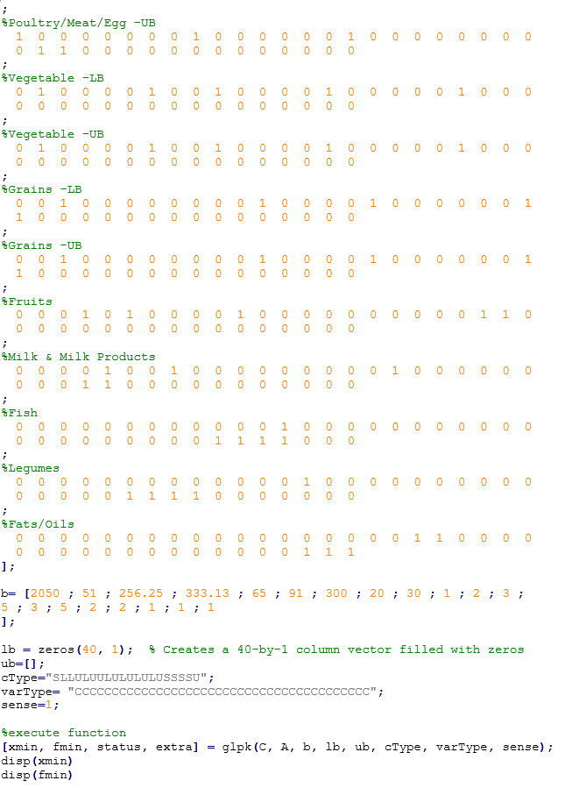
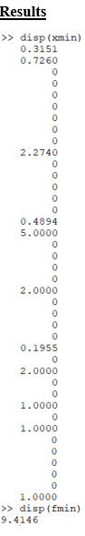
Octave code and results for group (Age 16-17, Male, APL 1.4) are shown as below.

Slide 16
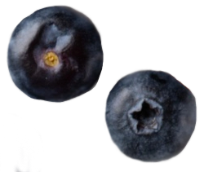
RESULTS
A
Function & Constraints | Actual | Requirements
Min Cost Function | 9.41
Calories | 2050 | = 2050
Protein | 83.78 | ≥ 51
Carbohydrates | 281.00 | 256.25≤ x ≤ 333.13
Fats | 65.00 | 65 ≤ x ≤ 91
Cholesterol | 300 | ≤ 300
Fibre | 27.67 | 20 ≤ x ≤ 30
Poultry/ Meat/ Egg | 1 | 1 ≤ x ≤ 2
Vegetable | 3 | 3 ≤ x ≤ 5
Grains | 5 | 3 ≤ x ≤ 5
Fruit | 2 | = 2
Milk & Milk Products | 2 | = 2
Fish | 1 | = 1
Legumes | 1 | = 1
Fats /oils | 1 | = 1
MAINTAIN A HEALTHY EATING LIFESTYLE - MAINTAIN A HEALTHY EATING LIFESTYLE
MAINTAIN A HEALTHY EATING LIFESTYLE - MAINTAIN A HEALTHY EATING LIFESTYLE
Food Type and Size | Formula (Value Generated by Octave * Single Serving Size)
37 g of Hard-boiled Egg | 0.3151 * 116g
38 g of Cucumber | 0.726 * 52 g
203 g of Cabbage | 2.274 * 89 g
42 g of Cooked Beef | 0.4894 * 85g
280 g of Fettuccine | 5 * 56g
280 g of Orange | 2 * 140g
2 g of Bacon | 0.1955 * 8g
12 g of Butter | 2 * 5.7g
90 g of Red Kidney Bean | 1 * 90g
143 g of Catfish | 1 * 143g
14 g of Cooking Oil | 1 * 14g
c
Notes:
By Using fmin function in Octave, the first table show that the minimum cost to get a daily healthy diet plan for population group (age 16-17, male with 1.4 PAL) is RM9.41, which is RM3.14 per meal, while fulfilling all the constraints which daily nutrients requirement and food group constraints.
The second table shows the optimal combination and amount of foods that are able to meet the requirements/constraints with the minimum cost in the first table.

Slide 17

Age Groups | Gender | Level of Physical Activity (PAL) | Minimum Cost (RM) | Recommended Food Type and Size (g)
< 18 | Male | 1.4 | 9.414527 | 37 g of Hard-boiled Egg, 38 g of Cucumber, 203 g of Cabbage, 42 g of Cooked Beef, 280 g of Fettuccine, 280 g of Orange, 2 g of Bacon, 12 g of Butter, 90 g of Red kidney bean, 143 g of Catfish, 14 g of Cooking Oil
 |  | 1.6 | 11.102 | 28 g of Hard-boiled Egg, 54 g of Banana, 267 g of Cabbage, 81 g of Cooked Beef, 280 g of Fettuccine, 217 g of Orange, 12 g of Butter, 90 g of Red kidney bean, 143 g of Catfish, 13 g of Peanut, 8 g of Cooking Oil
 |  | 1.8 | 18.616 | 51 g of Cucumber, 236 g of Banana, 34 g of Sliced Cheese, 118 g of Grilled Chicken, 182 g of Cabbage, 70 g of Cooked Beef, 128 g of Fettuccine, 137 g of Rice Vermicelli, 1 g of Bacon, 164 g of Chickpea, 111 g of Catfish, 23 g of Saba Mackerel, 28 g of Peanut
 |  | 2.0 | 26.158 | 34 g of Cucumber, 236 g of Banana, 137 g of Greek Yogurt, 100 g of Grilled Chicken, 388 g of Cabbage, 86 g of Cooked Beef, 272 g of Milk, 300 g of Rice Vermicelli, 164 g of Chickpea, 135 g of Catfish, 7 g of Saba Mackerel, 28 g of Peanut
 | Female | 1.4 | 7.8961 | 41 g of Hard-boiled Egg, 156 g of Cucumber, 266 g of Brown rice, 23 g of Cooked Beef, 132 g of Fettuccine, 280 g of Orange, 4 g of Bacon, 12 g of Butter, 90 g of Red kidney bean, 143 g of Catfish, 14 g of Cooking Oil
 |  | 1.6 | 8.5932 | 41 g of Hard-boiled Egg, 152 g of Cucumber, 9 g of Cabbage, 23 g of Cooked Beef, 280 g of Fettuccine, 280 g of Orange, 4 g of Bacon, 12 g of Butter, 90 g of Red kidney bean, 143 g of Catfish, 14 g of Cooking Oil
 |  | 1.8 | 9.8395 | 35 g of Hard-boiled Egg, 267 g of Cabbage, 53 g of Cooked Beef, 280 g of Fettuccine, 280 g of Orange, 1 g of Bacon, 12 g of Butter, 90 g of Red kidney bean, 143 g of Catfish, 14 g of Cooking Oil
 |  | 2.0 | 13.379 | 21 g of Hard-boiled Egg, 156 g of Cucumber, 236 g of Banana, 34 g of Sliced Cheese, 44 g of Grilled Chicken, 14 g of Japanese Pressed Tofu, 45 g of Cooked Beef, 280 g of Fettuccine, 138 g of Chickpea, 143 g of Catfish, 28 g of Peanut
Notes:
We have taken the age 16-17 male with 1.4 PAL as example. These are the rest of different age group, gender and level of physical activity.

Slide 18
Age Groups | Gender | Level of Physical Activity (PAL) | Minimum Cost (RM) | Recommended Food Type and Size (g)
≥ 18 - 29 | Male | 1.4 | 9.0253 | 38 g of Hard-boiled Egg, 156 g of Cucumber, 15 g of Brown rice, 37 g of Cooked Beef, 273 g of Fettuccine, 280 g of Orange, 2 g of Bacon, 12 g of Butter, 90 g of Red kidney bean, 143 g of Catfish, 14 g of Cooking Oil
 |  | 1.6 | 10.521 | 34 g of Hard-boiled Egg, 186 g of Banana, 267 g of Cabbage, 57 g of Cooked Beef, 280 g of Fettuccine, 61 g of Orange, 1 g of Bacon, 12 g of Butter, 90 g of Red kidney bean, 143 g of Catfish, 13 g of Peanut, 8 g of Cooking Oil
 |  | 1.8 | 18.759 | 220 g of Cucumber, 236 g of Banana, 34 g of Sliced Cheese, 151 g of Grilled Chicken, 69 g of Cabbage, 42 g of Cooked Beef, 171 g of Fettuccine, 98 g of Rice Vermicelli, 164 g of Chickpea, 98 g of Catfish, 32 g of Saba Mackerel, 28 g of Peanut
 |  | 2.0 | 38.599 | 236 g of Banana, 340 g of Greek Yogurt, 132 g of Grilled Chicken, 430 g of Oyster Mushroom, 59 g of Cooked Beef, 250 g of Fettuccine, 28 g of Rice Vermicelli, 164 g of Chickpea, 63 g of Catfish, 96 g of Red Snapper, 28 g of Peanut
 | Female | 1.4 | 7.6955 | 42 g of Hard-boiled Egg, 156 g of Cucumber, 302 g of Brown rice, 20 g of Cooked Beef, 112 g of Fettuccine, 280 g of Orange, 4 g of Bacon, 12 g of Butter, 90 g of Red kidney bean, 143 g of Catfish, 14 g of Cooking Oil
 |  | 1.6 | 8.3909 | 42 g of Hard-boiled Egg, 156 g of Cucumber, 35 g of Brown rice, 20 g of Cooked Beef, 261 g of Fettuccine, 280 g of Orange, 4 g of Bacon, 12 g of Butter, 90 g of Red kidney bean, 143 g of Catfish, 14 g of Cooking Oil
 |  | 1.8 | 9.5884 | 39 g of Hard-boiled Egg, 102 g of Banana, 267 g of Cabbage, 36 g of Cooked Beef, 280 g of Fettuccine, 160 g of Orange, 3 g of Bacon, 12 g of Butter, 90 g of Red kidney bean, 143 g of Catfish, 13 g of Peanut, 8 g of Cooking Oil
 |  | 2.0 | 14.445 | 9 g of Hard-boiled Egg, 156 g of Cucumber, 236 g of Banana, 34 g of Sliced Cheese, 104 g of Grilled Chicken, 14 g of Japanese Pressed Tofu, 26 g of Cooked Beef, 280 g of Fettuccine, 138 g of Chickpea, 143 g of Catfish, 28 g of Peanut

Slide 19
Age Groups | Gender | Level of Physical Activity (PAL) | Minimum Cost (RM) | Recommended Food Type and Size (g)
30 - 59 | Male | 1.4 | 8.8796 | 39 g of Hard-boiled Egg, 156 g of Cucumber, 50 g of Brown rice, 36 g of Cooked Beef, 253 g of Fettuccine, 280 g of Orange, 3 g of Bacon, 12 g of Butter, 90 g of Red kidney bean, 143 g of Catfish, 14 g of Cooking Oil
 |  | 1.6 | 10.21 | 34 g of Hard-boiled Egg, 96 g of Banana, 267 g of Cabbage, 54 g of Cooked Beef, 280 g of Fettuccine, 167 g of Orange, 1 g of Bacon, 12 g of Butter, 90 g of Red kidney bean, 143 g of Catfish, 13 g of Peanut, 8 g of Cooking Oil
 |  | 1.8 | 16.956 | 156 g of Cucumber, 236 g of Banana, 34 g of Sliced Cheese, 133 g of Grilled Chicken, 41 g of Cooked Beef, 224 g of Fettuccine, 50 g of Rice Vermicelli, 2 g of Bacon, 164 g of Chickpea, 124 g of Catfish, 14 g of Saba Mackerel, 28 g of Peanut
 |  | 2.0 | 35.008 | 236 g of Banana, 340 g of Greek Yogurt, 127 g of Grilled Chicken, 301 g of Cabbage, 140 g of Oyster Mushroom, 63 g of Cooked Beef, 61 g of Fettuccine, 197 g of Rice Vermicelli, 164 g of Chickpea, 75 g of Catfish, 82 g of Red Snapper, 28 g of Peanut
 | Female | 1.4 | 7.8961 | 41 g of Hard-boiled Egg, 156 g of Cucumber, 266 g of Brown rice, 23 g of Cooked Beef, 132 g of Fettuccine, 280 g of Orange, 4 g of Bacon, 12 g of Butter, 90 g of Red kidney bean, 143 g of Catfish, 14 g of Cooking Oil
 |  | 1.6 | 8.6321 | 41 g of Hard-boiled Egg, 128 g of Cucumber, 49 g of Cabbage, 23 g of Cooked Beef, 280 g of Fettuccine, 280 g of Orange, 4 g of Bacon, 12 g of Butter, 90 g of Red kidney bean, 143 g of Catfish, 14 g of Cooking Oil
 |  | 1.8 | 9.8994 | 38 g of Hard-boiled Egg, 192 g of Banana, 267 g of Cabbage, 39 g of Cooked Beef, 280 g of Fettuccine, 53 g of Orange, 2 g of Bacon, 12 g of Butter, 90 g of Red kidney bean, 143 g of Catfish, 13 g of Peanut, 8 g of Cooking Oil
 |  | 2.0 | 15.859 | 156 g of Cucumber, 236 g of Banana, 34 g of Sliced Cheese, 131 g of Grilled Chicken, 27 g of Cooked Beef, 256 g of Fettuccine, 23 g of Rice Vermicelli, 4 g of Bacon, 164 g of Chickpea, 143 g of Catfish, 15 g of Peanut, 7 g of Cooking Oil

Slide 20
Age Groups | Gender | Level of Physical Activity (PAL) | Minimum Cost (RM) | Recommended Food Type and Size (g)
≥ 60 | Male | 1.4 | 8.3329 | 40 g of Hard-boiled Egg, 156 g of Cucumber, 159 g of Brown rice, 28 g of Cooked Beef, 192 g of Fettuccine, 280 g of Orange, 3 g of Bacon, 12 g of Butter, 90 g of Red kidney bean, 143 g of Catfish, 14 g of Cooking Oil
 |  | 1.6 | 9.273 | 38 g of Hard-boiled Egg, 267 g of Cabbage, 36 g of Cooked Beef, 280 g of Fettuccine, 280 g of Orange, 3 g of Bacon, 12 g of Butter, 90 g of Red kidney bean, 143 g of Catfish, 14 g of Cooking Oil
 |  | 1.8 | 12.094 | 32 g of Hard-boiled Egg, 156 g of Cucumber, 236 g of Banana, 34 g of Sliced Cheese, 11 g of Grilled Chicken, 14 g of Japanese Pressed Tofu, 36 g of Cooked Beef, 280 g of Fettuccine, 2 g of Bacon, 138 g of Chickpea, 143 g of Catfish, 28 g of Peanut
 |  | 2.0 | 23.405 | 34 g of Cucumber, 236 g of Banana, 60 g of Greek Yogurt, 145 g of Grilled Chicken, 388 g of Cabbage, 48 g of Cooked Beef, 375 g of Milk, 250 g of Rice Vermicelli, 164 g of Chickpea, 119 g of Catfish, 18 g of Saba Mackerel, 28 g of Peanut
 | Female | 1.4 | 7.4647 | 43 g of Hard-boiled Egg, 156 g of Cucumber, 350 g of Brown rice, 17 g of Cooked Beef, 85 g of Fettuccine, 280 g of Orange, 4 g of Bacon, 12 g of Butter, 90 g of Red kidney bean, 143 g of Catfish, 14 g of Cooking Oil
 |  | 1.6 | 8.1299 | 43 g of Hard-boiled Egg, 156 g of Cucumber, 94 g of Brown rice, 17 g of Cooked Beef, 228 g of Fettuccine, 280 g of Orange, 4 g of Bacon, 12 g of Butter, 90 g of Red kidney bean, 143 g of Catfish, 14 g of Cooking Oil
 |  | 1.8 | 9.0464 | 40 g of Hard-boiled Egg, 267 g of Cabbage, 30 g of Cooked Beef, 280 g of Fettuccine, 280 g of Orange, 3 g of Bacon, 12 g of Butter, 90 g of Red kidney bean, 143 g of Catfish, 14 g of Cooking Oil
 |  | 2.0 | 12.304 | 29 g of Hard-boiled Egg, 156 g of Cucumber, 236 g of Banana, 34 g of Sliced Cheese, 36 g of Grilled Chicken, 14 g of Japanese Pressed Tofu, 23 g of Cooked Beef, 280 g of Fettuccine, 2 g of Bacon, 138 g of Chickpea, 143 g of Catfish, 28 g of Peanut

Slide 21
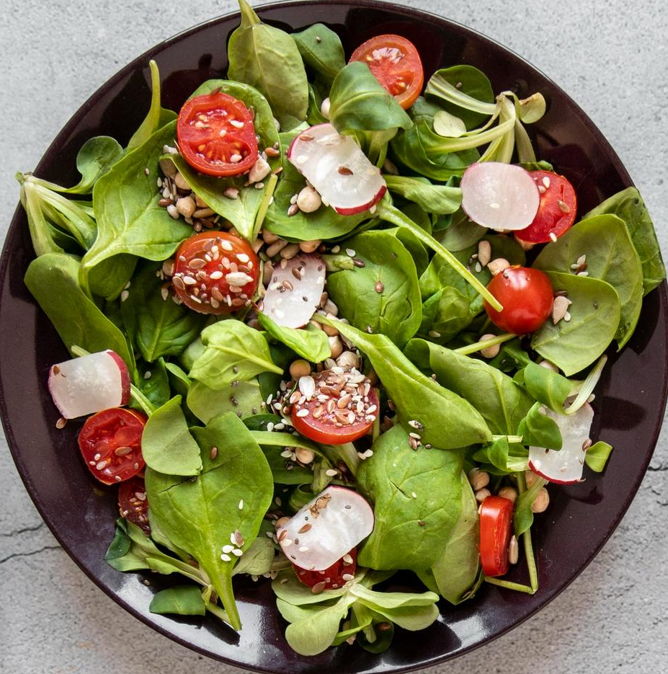
CONCLUSION
A
FEELING GOOD IS LOOKING GOOD - FEELING GOOD IS LOOKING GOOD
A healthy diet plan should vary based on individuals from different age groups, gender, and level of physical activity, instead of producing a one-size-fits-all solution.​
Based on the data gathered, linear programming emerges as the ideal technique for implementing a diet cost optimization model:
Due to its compatibility with linearly expressed objective functions (minimizing cost)
Constraints (nutritional requirements, recommended dietary intakes)
Efficiency and flexibility in handling large-scale problems.​
FEELING GOOD IS LOOKING GOOD - FEELING GOOD IS LOOKING GOOD
FEELING GOOD IS LOOKING GOOD - FEELING GOOD IS LOOKING GOOD
P

Slide 22
REFERENCES
D
Abrishami, Bahareh; Meng, Lingyi; Nazarijam, Parisa; Rahmani, Sharifa; Xie, Yining; Yang, Zhe, OCTAVE Allegro Risk Assessment. https://zenodo.org/record/1436006/files/OCTAVE%20Allegro%20Risk%20Assessment.pdf
Alaini, Reham; Rajikan, Roslee; Elias, Siti Masitah, 2019, "Diet optimization using linear programming to develop low cost cancer prevention food plan for selected adults in Kuala Lumpur, Malaysia". https://d-nb.info/1200395387/34
Donato. M (2020), Optimization with machine learning-based modeling: an application to humanitarian food aid. https://amslaurea.unibo.it/21621/1/Maragno_Donato_Thesis.pdf
Fao.org. FAO Food Price Index | World Food Situation | Food and Agriculture Organization of the United Nations. (n.d.). https://www.fao.org/worldfoodsituation/foodpricesindex/en/
Gupta.S ; Ahteshamul.H; and Irfan.A, 2022, "Neutrosophic Goal Programming Approach for the Dash Diet Model". https://digitalrepository.unm.edu/cgi/viewcontent.cgi?article=2084&context=nss_journal
Kirk, Daniel, Kok, Esther, Tufano, Michele, Tekinerdogan, Bedir, Feskens, Edith JM, and Camps, Guido, 2022, "Machine Learning in Nutrition Research". https://edepot.wur.nl/584260
A

Slide 23
D
REFERENCES
Ministry of Health, Malaysia (2017). Recommended Nutrient Intakes for Malaysia. (n.d.-a). https://hq.moh.gov.my/nutrition/wp-content/uploads/2017/05/FA-Buku-RNI.pdf
Ministry of Health, Malaysia (2020). Malaysian Dietary Guidelines 2020. (n.d.-b). https://hq.moh.gov.my/nutrition/wp-content/uploads/2021/07/Web%20MDG.pdf
Rao, M., Afshin, A., Singh, G., & Mozaffarian, D. (2013). Do healthier foods and diet patterns cost more than less healthy options? A systematic review and meta-analysis. BMJ Open, 3(12). https://doi.org/10.1136/bmjopen-2013-004277
Tadia. VK, 2021, "Nutrient and Cost Optimization in Menu Planning at an Apex Tertiary Care Hospital Using Operational Research Techniques". https://ijop.net/index.php/mlu/article/download/2474/2173/4811
Yona, O., Goldsmith, R., & Endevelt, R. (2020). Improved meals service and reduced food waste and costs in medical institutions resulting from employment of a food service dietitian – a case study. Israel Journal of Health Policy Research, 9(1). https://doi.org/10.1186/s13584-020-0362-0
A

Slide 24
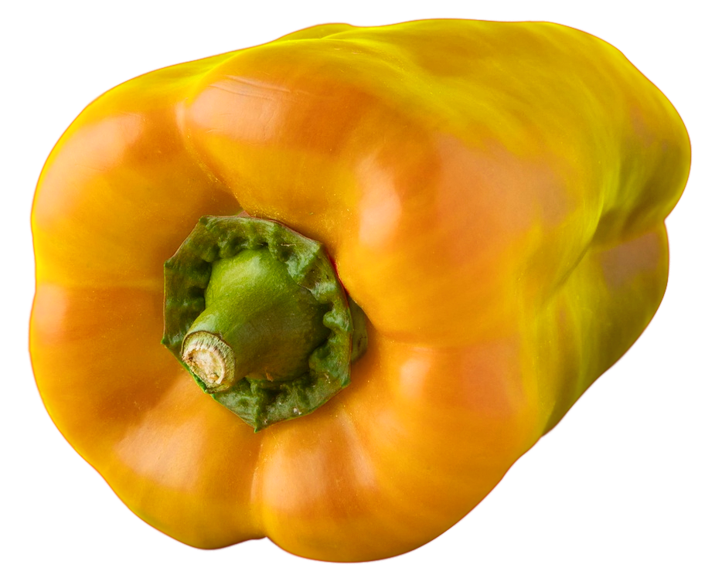
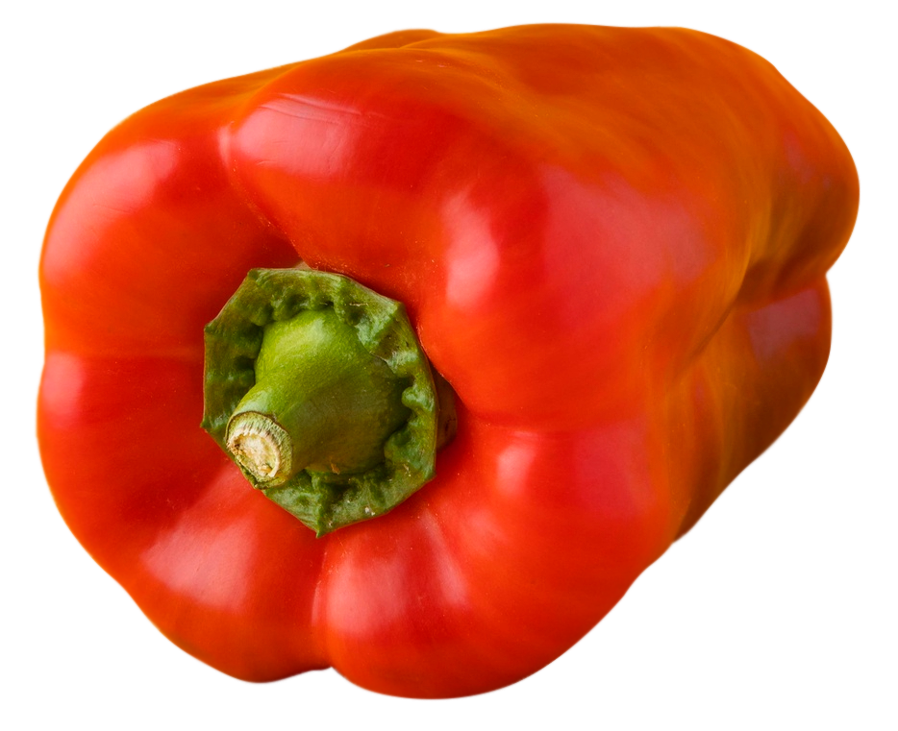
THANK YOU
HEALTHY FOOD, HEALTHY LIFE - HEALTHY FOOD, HEALTHY LIFE - HEALTHY FOOD, HEALTHY LIFE
B
N
HEALTHY FOOD, HEALTHY LIFE - HEALTHY FOOD, HEALTHY LIFE - HEALTHY FOOD, HEALTHY LIFE

